Slide 1
Mailstops
We need them!

Slide 2
Tired of always having to reroute misdirected mail?
There’s a cure for that!

Slide 3
Mailstops are the answer! Ever used them? They’re easy!

Slide 4
How Mailstops Work
Mailstops are not based on a person, but on a location; so a mailstop stays at one place
e.g. Joe, in Bright Success Center on the 2nd floor of Kolligian would have mailstop KL2B. Meg, in DARTS on the 2nd floor of Kolligian would also be KL2B. Ted (a librarian) in Kolligian on the 2nd floor of the Library, would have KL2A.
The 3rd floor would be KL3B (offices side of Kolligian), and the 1st floor would be KL 3A and KL 3B, depending on which side of the building the offices were located.

Slide 5
How Mailstops Work
Other campus buildings would work the same way.
Each mailroom has at least one mailstop. The online Directory should include each person’s mailstop. Departments would have their list (if more than one) mailstops, including location in the Directory.
If the person moves to a new location, the person is assigned to the new mailstop, and the Directory would need updating. (e.g. Meg in DARTS, KL2B, moves to Mondo, 2nd floor. Her new mailstop will be MO2.)

Slide 6
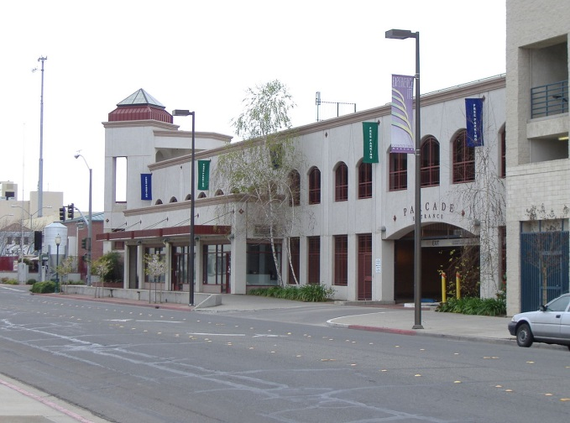
Every location would have at least one mailstop, and more would be added as locations or buildings are added.

Slide 7
How Mailstops Work
On the envelope, write the person’s name Add the mailstop designation. That’s it!
(Your Name) MS KL2B
Include the mailstop on your business card mailing addresses, and for all external mail so mail will come directly through the mailroom to the mailstop instead of a generic address, such as N. 5200 Lake Road. This helps avoid mail getting routed through guesswork.
(Your Name)
University of California, Merced
N. 5200 Lake Road, MS KL2B
Merced, CA 95343

Slide 8
It’s Time!
Many campuses use mailstops to help improve the flow of mail. UC Merced is large enough now to start, and yet small enough to easily make mailstop use part of the everyday system.
Let’s save time and money—let’s start using mailstops now!

